Slide 1
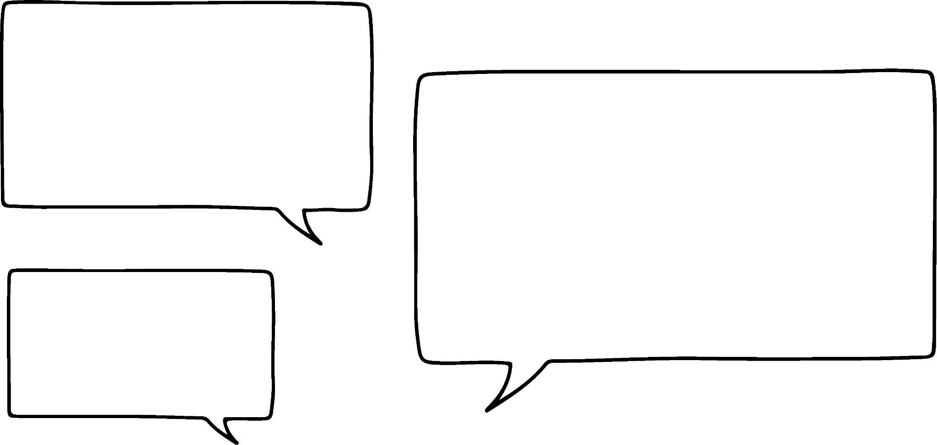
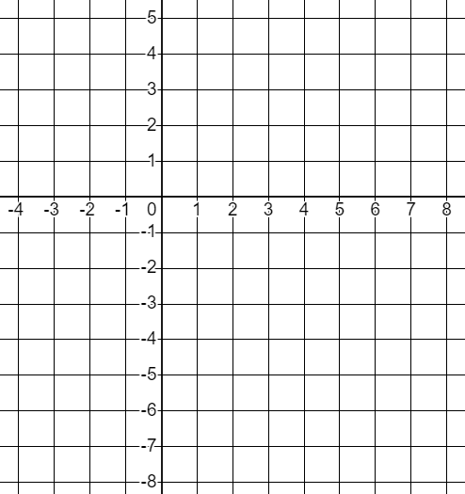
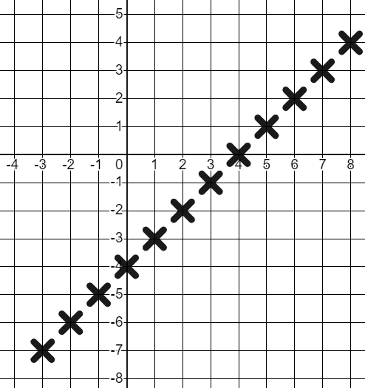
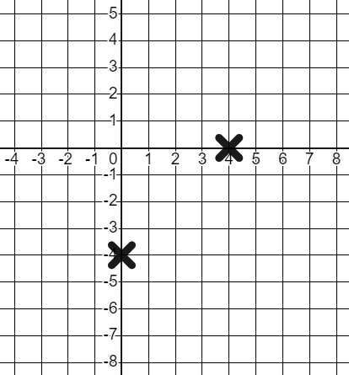


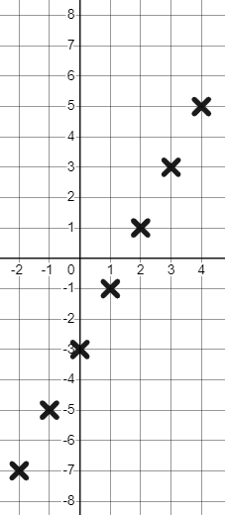
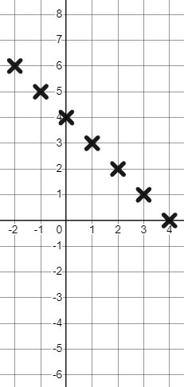
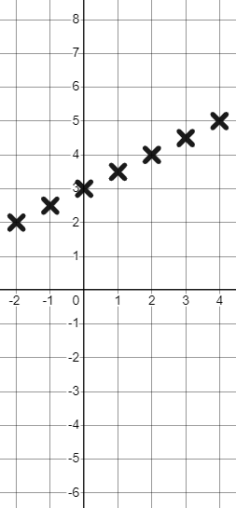
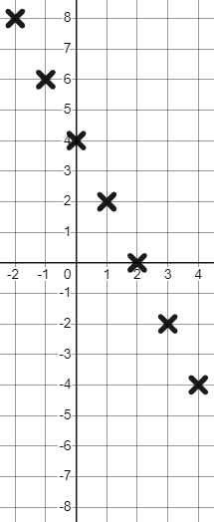
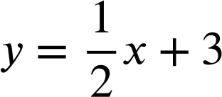
Checking and securing plotting a relationship
Task A: Checking understanding of plotting a coordinate
1) Laura says...
Laura’s number
Whatever number Andeep chooses I’m going to subtract 4 from it.
Andeep’s number
Plot some points to graphically represent this relationship.
2) Complete the tables of values and plot these relationships.
a)
x | −2 | −1 | 0 | 1 | 2 | 3 | 4
y | −7 | −5 | −3 | −1 | 1 | 3 | 5
y = 2x − 3
b)
x | −2 | −1 | 0 | 1 | 2 | 3 | 4
y | 6 | 5 | 4 | 3 | 2 | 1 | 0
x + y = 4
c)
x | −2 | −1 | 0 | 1 | 2 | 3 | 4
y | 2 | 2.5 | 3 | 3.5 | 4 | 4.5 | 5
d)
x | −2 | −1 | 0 | 1 | 2 | 3 | 4
y | 8 | 6 | 4 | 2 | 0 | −2 | −4
y = 4 − 2x

Slide 2
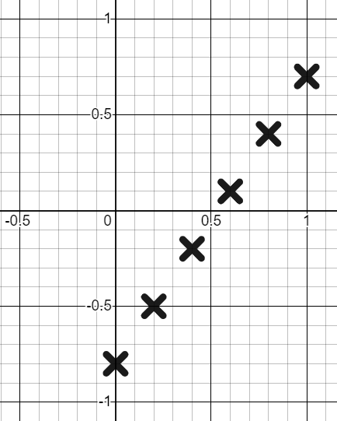
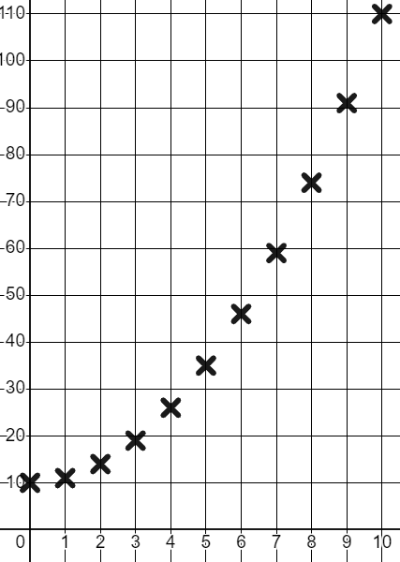
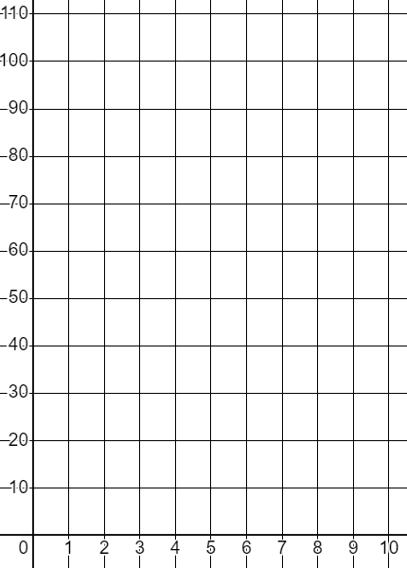
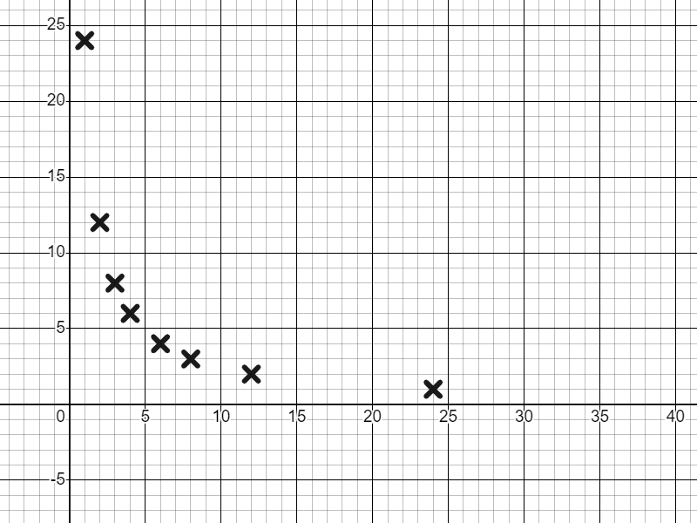
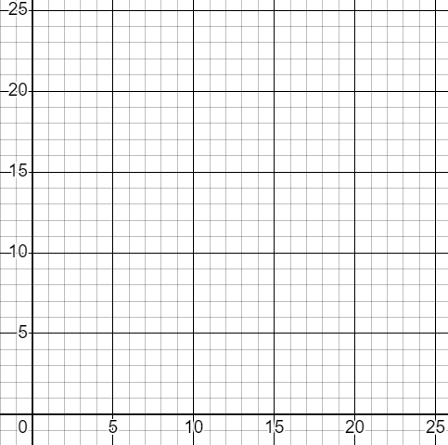
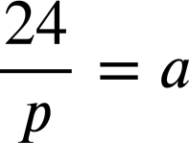
Checking and securing plotting a relationship
3) Complete the tables of values for this relationship.
y = 1.5x − 0.8
x | 0 | 0.2 | 0.4 | 0.6 | 0.8 | 1
y | −0.8 | −0.5 | −0.2 | 0.1 | 0.4 | 0.7
Draw suitable axes to graphically represent the coordinates.
Task B: Securing understanding of plotting a relationship
1) This time Andeep is squaring Laura’s number and adding 10.
Laura (L) | 1 | 2 | 3 | 4 | 5 | 6 | 7 | 8 | 9 | 10
Andeep (A) | 11 | 14 | 19 | 26 | 35 | 46 | 59 | 74 | 91 | 110
1
11
5
35
a) Complete the table of values and plot the relationship.
Andeep’s number
b) Explain why (5,25) is not on this curve.
It does not fit the relationship. 5² + 10 ≠ 25
Laura’s number
c) Write this relationship algebraically.
A = L² + 10
2) This time our Oak children are sharing 24 apples.
a) Complete the table of values and plot the relationship.
People (p) | 1 | 2 | 3 | 4 | 6 | 8 | 12 | 24
Apples (a) | 24 | 12 | 8 | 6 | 4 | 3 | 2 | 1
b) Write this relationship algebraically.
Apples (a)
People (p)
Mathematics in Education and Industry
v2.2

